Slide 1
COMP 4290
Week 12 - Friday

Slide 2
Last time
What did we talk about last time?
Privacy

Slide 3
Questions?

Slide 4
Project 3

Slide 5
Assignment 4

Slide 6
Abiral Pokharel Presents

Slide 7
Exam 2 Post Mortem

Slide 8
Privacy in Emerging Technologies

Slide 9
RFID tags
Radio frequency identification (RFID) tags are usually small, inexpensive transmitters
They can be attached to almost anything
They can be as small as a grain of sand
Some are passive and need an external signal to power their response
Others have their own power supplies (and greater ranges)
Their transmission range varies from a few centimeters to several meters
They are currently used for:
Toll plaza payments
Some subway passes
Stock and inventory labels in warehouses
Passports and identity cards
Some credit cards with wave-style payment

Slide 10
RFID issues
RFID tags are being put in everything
A tag in your shirt could identify where you bought it and maybe even some unique identifier that could be tied to you in a database
This tag could be scanned as you walk down the street
Some people with rare medical conditions have an RFID implanted in their bodies
When I first taught this class, the infrastructure did not currently exist to track everyone's movements and activities
As the price goes down for RFID tags and their readers, widespread tracking becomes a greater likelihood

Slide 11
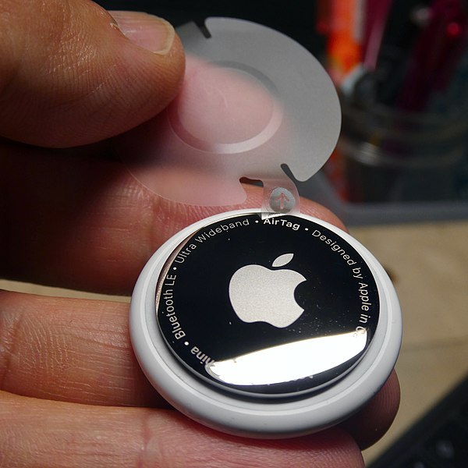
Apple AirTags
Apple AirTags were first released in 2021
You put them on and in things you worry about losing
They use a combination of short-range radio wave technologies like Bluetooth Low Energy, allowing Apple devices to track nearby ones
They are, essentially, RFIDs tracked by a global, crowd-sourced network
But toss one into someone's backpack or car and you suddenly have a way to stalk them
eBay and Etsy buyers have found AirTags with the warning speaker removed in items they have purchased
Security blogger Bruce Schneier had a post about how they're being used to track secret government offices
Image from: https://commons.wikimedia.org/wiki/File:Airtag_-_3.jpg
By user KKPCW
Creative Commons Attribution-Share Alike 4.0 International license

Slide 12
Electronic voting
Many polling places throughout the US (and many other countries) use computers to tally votes
Voting systems should:
Keep a voter's choices secret
Allow a voter to vote only once
Be tamperproof
Report votes accurately
Be available through the election period
Keep an audit trail to detect irregularities but still not say how an individual voted

Slide 13
Voting is a mess
It's hard to engineer a system that you can guarantee only lets someone vote once and yet not keep track of how they voted
The software and hardware design for these systems are generally not publicized
Nine companies are currently registered with the U.S. government to make voting systems
Internet voting will probably increase
Some US and UK elections have used it
Estonia has the largest Internet voting system, which relies on a national ID card that can be verified from home using an inexpensive card reader

Slide 14
VoIP
Voice over IP (VoIP) is a way to make phone calls over the Internet
Many phone companies actually use VoIP transparent to their users
The pandemic saw an increase in VoIP and other forms of Internet video communication
VoIP is attractive because long distance costs are essentially zero if you already have high speed Internet
Issues:
ISPs and others can track who you're having phone calls with, even if the audio is encrypted
Skype uses 256-bit AES (but it's hard to verify whether Microsoft can eavesdrop or not)
Zoom, Google Hangouts, Microsoft Teams, and Cisco Webex don't use end-to-end encryption, allowing the companies to eavesdrop
WhatsApp claims to use end-to-end encryption

Slide 15
Upcoming

Slide 16
Next time…
Security planning
Disasters
Lockpicking
Jennifer Perez presents

Slide 17
Reminders
Work on Project 3
Phase 1 due next Friday
Keep reading Chapter 10

